Slide 1
Tangent and normal
(in cartesian coordinates)

Slide 3
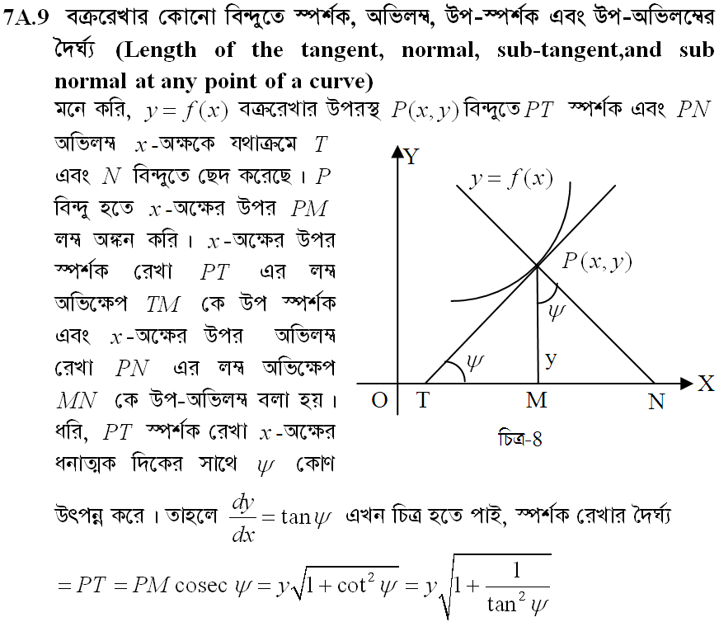

Slide 4
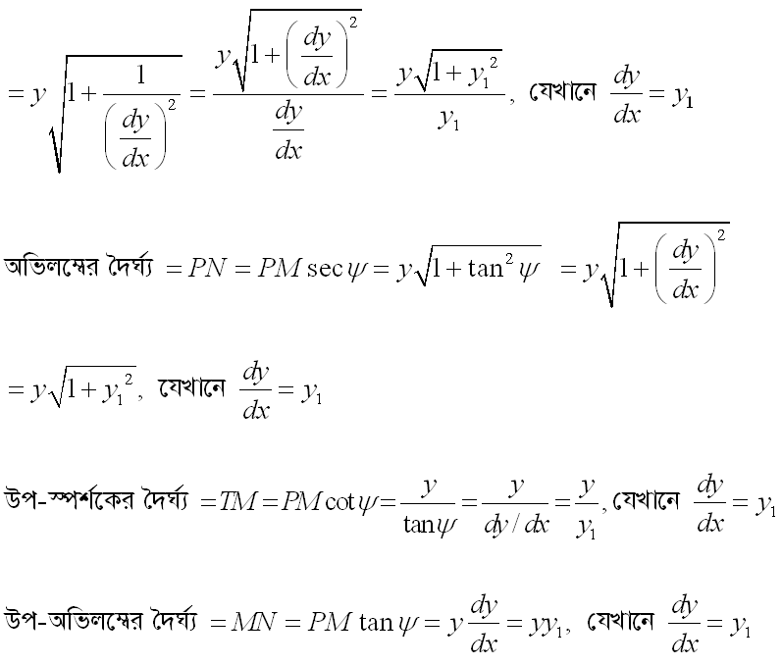

Slide 5
